Slide 1
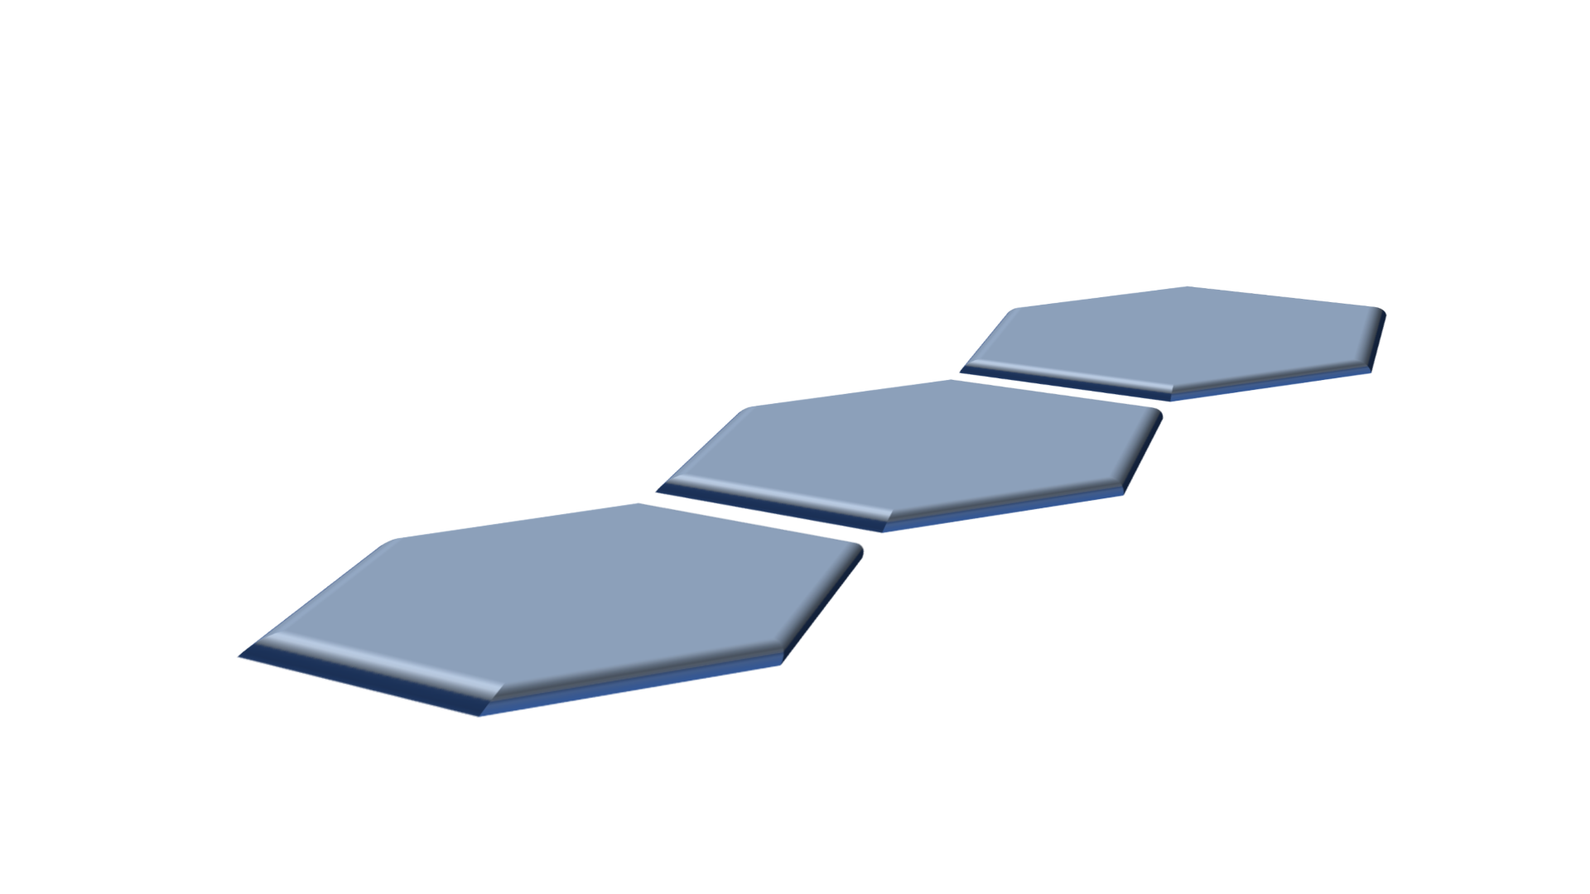
Apache
Causeway

