Slide 1
Deploying Science Gateways with Apache Airavata
Marcus Christie, Eroma Abeysinghe, Marlon Pierce, and the CIRC team
circ@iu.edu

Slide 2
What Is Apache Airavata?
Middleware for managing users, workflow executions, data transfers, and metadata for science gateways
Airavata can integrate university, XSEDE, and other resources that your gateway needs.

Slide 3
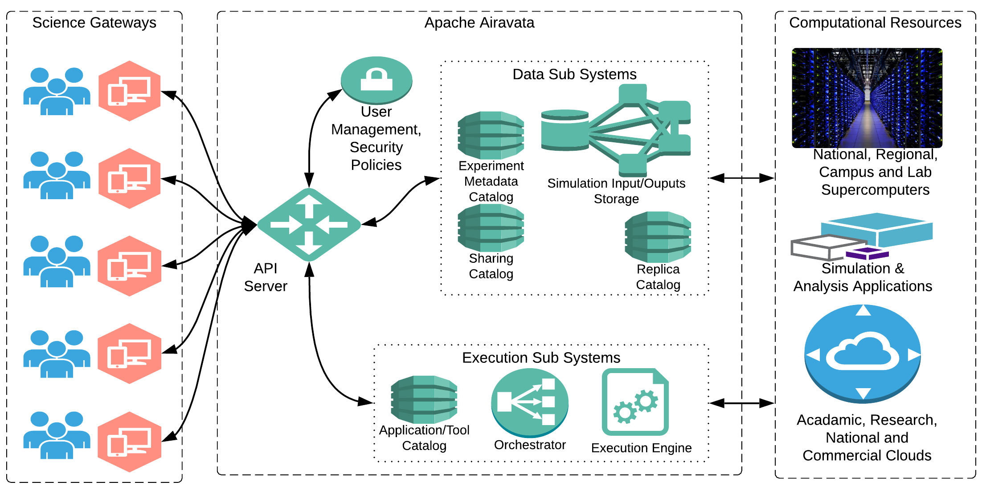
Django Portal for Airavata

Slide 4
What We Will Cover
How to use a turnkey Django gateway to work with Airavata middleware
How to customize the look and feel
How to create custom applications in a local Django installation

Slide 5
The one link for all tutorial material
https://cwiki.apache.org/confluence/display/AIRAVATA/PEARC+2021+Tutorial+Agenda

Slide 6
Why Use Apache Airavata?
We host everything on the Science Gateway Platform as a service
You bring the resources, scientific applications, etc
Start with our turnkey gateway...
But we can help you design and build highly customized interfaces for your user community

Slide 7
How to Work with Us
For XSEDE gateways, request Extended Collaborative Support Services (through January 2022)
Non-XSEDE gateways: we will give you a free trial for 1 month
Work with us through the Science Gateways Community Institute

