Slide 1


A Framework to capture and reproduce the Absolute State of Jupyter Notebooks
Dimuthu Wannipurage
Cyber Infrastructure Integration Research Center
Indiana University

Slide 2
Standard Notebooks
Basic local deployment
Cloud based deployments (JupyterHub, Colab)
Reproducible Notebooks https://mybinder.org/
Recent Research: Multi / Hybrid cloud notebooks

Slide 3
Reproducibility of Notebooks: Why?
Local to Cloud, Cloud to Local deployments
Reproducing published work
Classroom learning materials
Utilizing on-demand / time-bound resources for long running notebooks

Slide 4
Reproducibility of a Notebook : Current Approach
Source can be distributed as an ipynb file
Library and environment setup instruction are distributed in a separate readme
Additional supporting files also should be handpicked and separately distributed
There is no standard way to capture the internal session state of a notebook

Slide 5
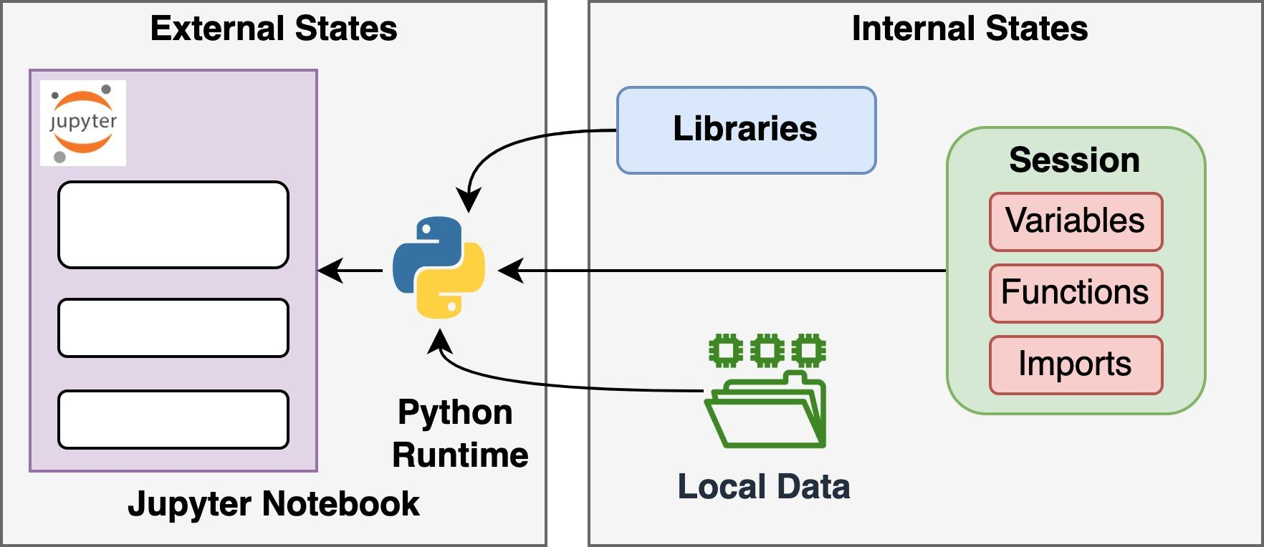
Absolute state of a Notebook
We need to capture all following states to have a fully reproducible notebook
Source code
Supporting data files
Libraries
Runtime Session

Slide 6
Novel approach to capture absolute state of Notebooks
Jupyter Magic extensions to capture internal states
External system call monitoring to capture environment states
Well-defined state representation model and archiving techniques
Reproducing notebooks from already captured states

Slide 7
Hands-on Session 1
Go to http://149.165.154.162:3000 and login through CILogon
Go to dashboard
Create a Notebook
Generate a random number file from shorturl.at/jnRU8
Upload downloaded file to the Notebook server
Refer to the coding guide at shorturl.at/AGKMX
Recreate the notebook in cloud
Recreate the notebook locally

Slide 8
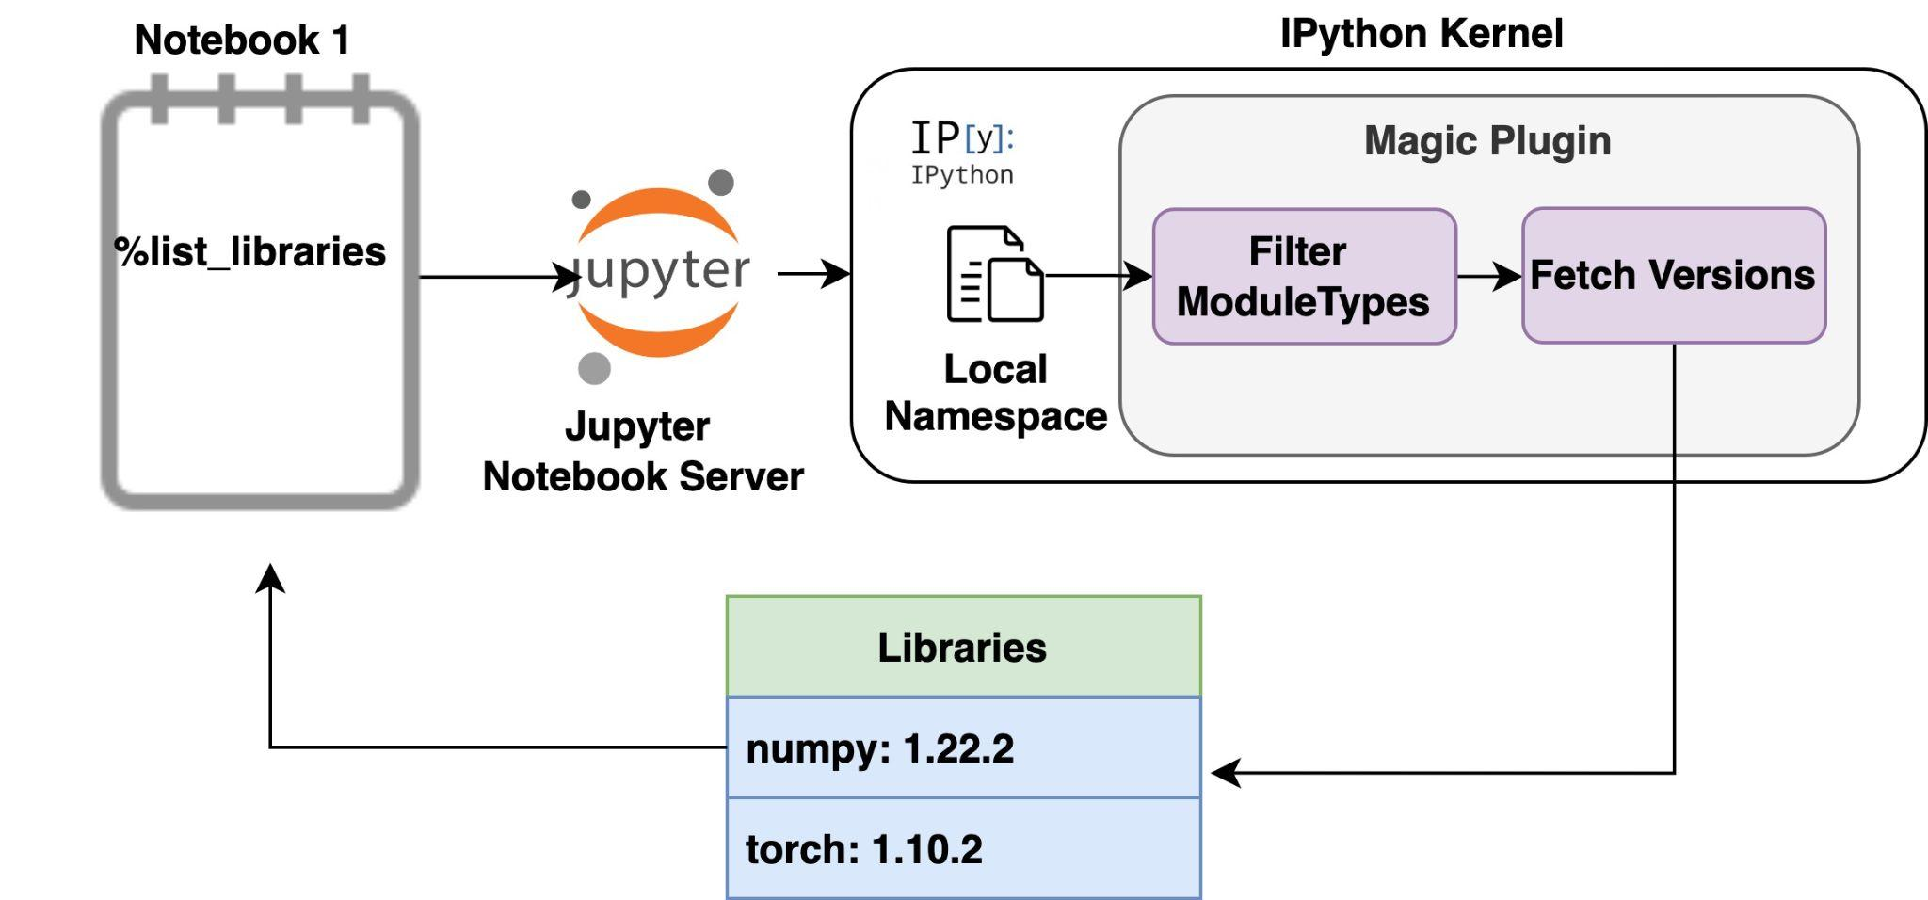
Capturing Library import information
Jupyter Magic extension to capture internal session objects
Filter out module type objects from the session
Derive corresponding versions
Export metadata

Slide 9
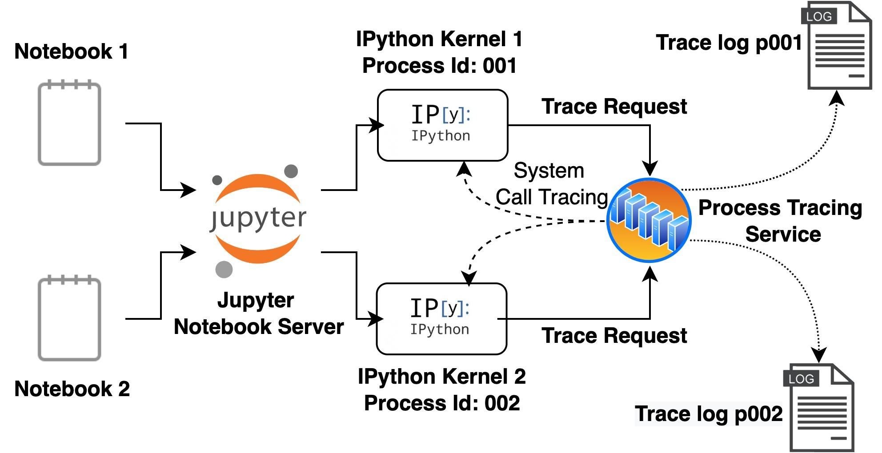
Capturing External Data dependencies
Side-car tracing server to monitor file system calls of the target Notebook
Unix server socket between the tracing server and ipython kernel to control monitoring operations

Slide 10
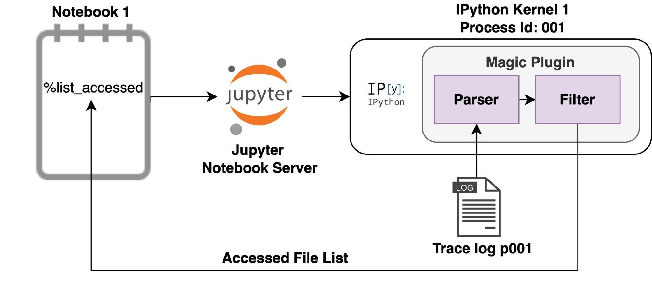
Capturing External Data dependencies
Dedicated magic extension to filter out relevant data files and ignore unnecessary library and temporary files
Creating the metadata file which tracks original file names to a unique identifier

Slide 11
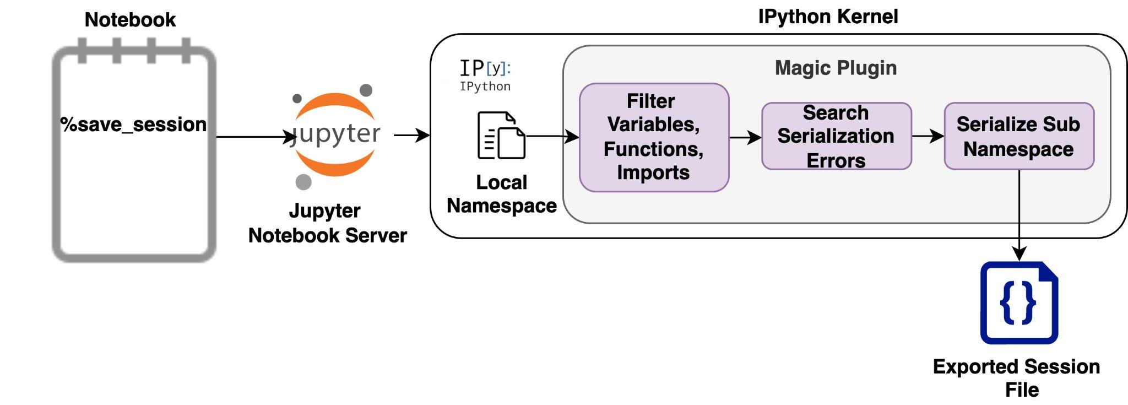
Capturing Notebook Session
Jupyter Magic extension to capture Notebook session from iPython kernel API
Filter out public objects, function and imports
Byte level serialization of those objects with the compatibility to reload into the memory of a different runtime

Slide 12
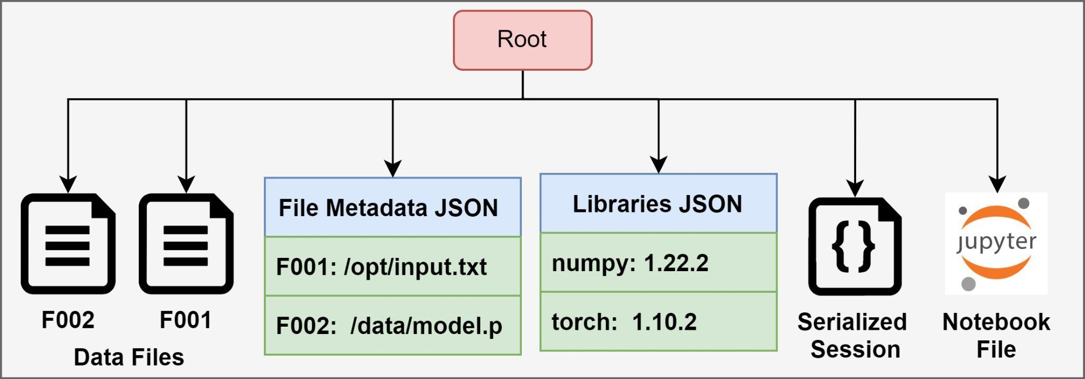
Aggregating total state representation
Place external data files, library imports, serialized session and Notebook file in a zip archive

Slide 13
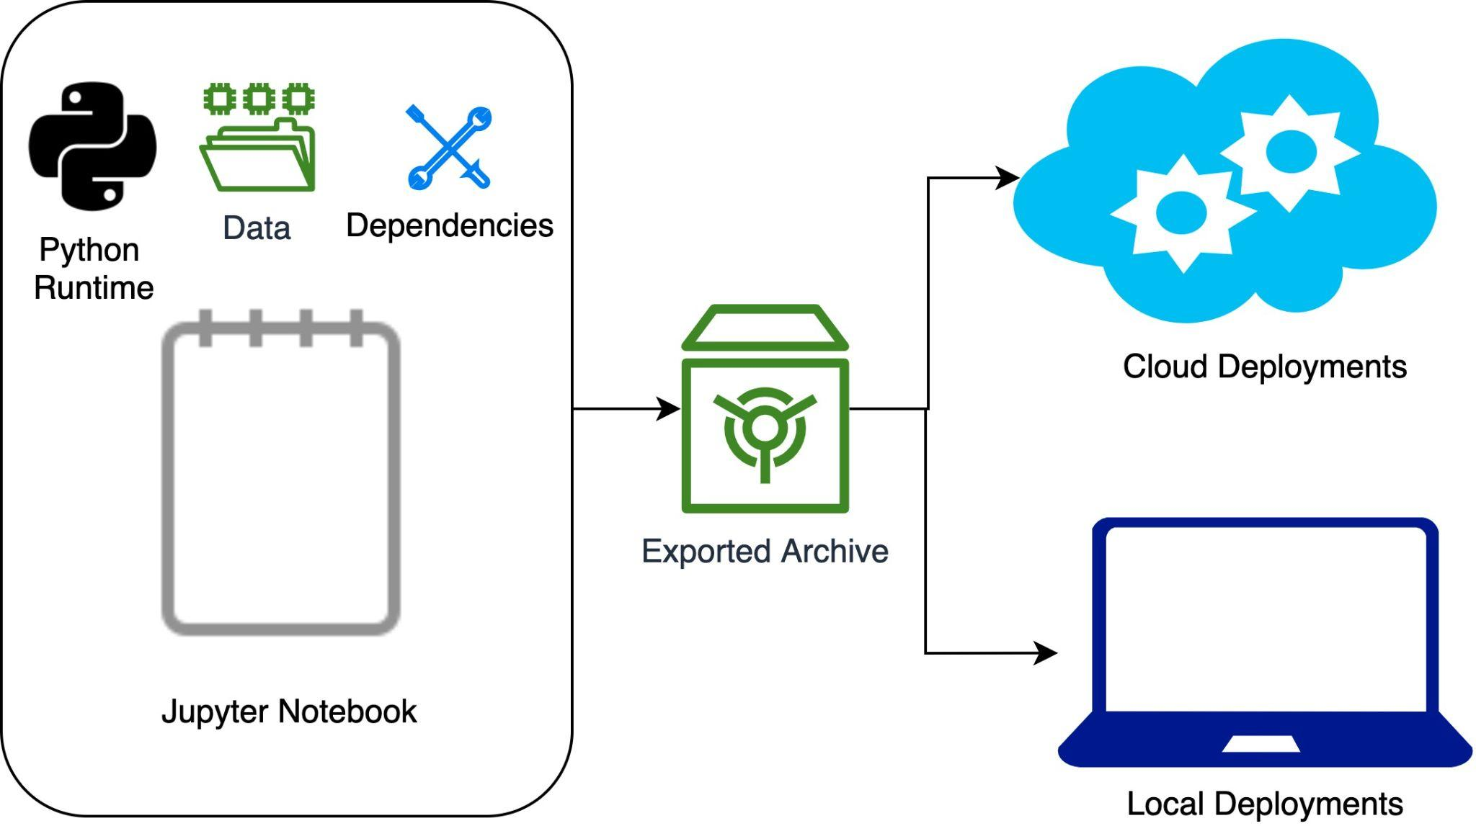
Recreating exported session

Slide 14
Hands-on Session 2
Running MNIST on cloud and post processing locally

Slide 15
Performance
Todo

Slide 16
Thank You

