Slide 1

Presentation Title
NAME | PMC Apache StreamPipes
Venue | Date

Slide 3
Project Overview

Slide 5
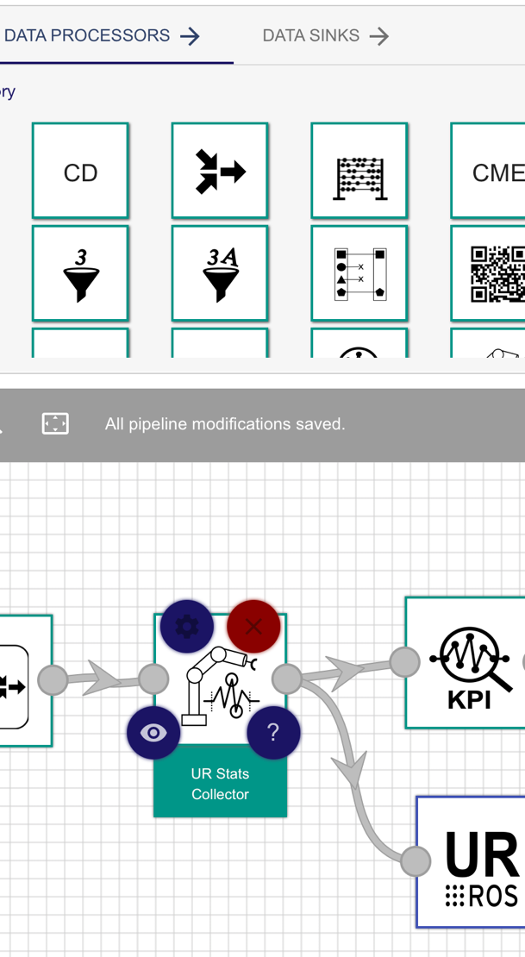




Let‘s connect!
streampipes.apache.org
streampipes.apache.org/docs
apache/streampipes
@streampipes

