Slide 1
ATS Internals
Source Code Reading & Analysis
by Oknet
xuchao@skyguard.com.cn

Slide 2
Directory
CH01 EventSystem (done & in translating)
CH02 IOCore Net Sub-system (done & to be trans)
CH03 IOCore SSL Sub-system(done & to be trans)
CH04 Session(done & to be trans)
CH05 State Machine (in-progress)
CH06 HostDB Sub-system
CH07 DNS Sub-system
CH08 HttpSM
CH09 AIO Sub-system
CH10 Cache Sub-system
CH11 Log Sub-system

Slide 3
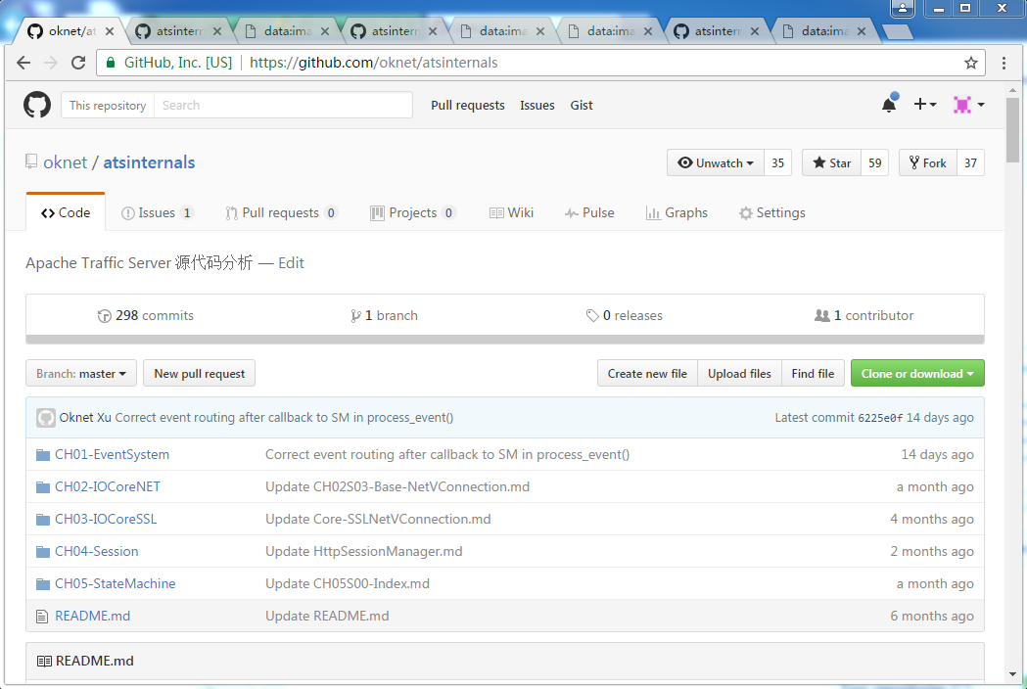
https://github.com/oknet/atsinternals

Slide 4
EventSystem
Base
  ProxyMutex
  Continuation
  Lock
Core
  ClassAllocator (Global object allocator) & Allocator
  ProxyAllocator (Thread local object allocator) & freelist
  EThread (run / process Event) & Thread
  Event (Signal / command to the engine) & Action
Interface
  eventProcessor & Processor
  Singleton, create EThread group / pool for the engine

Slide 5
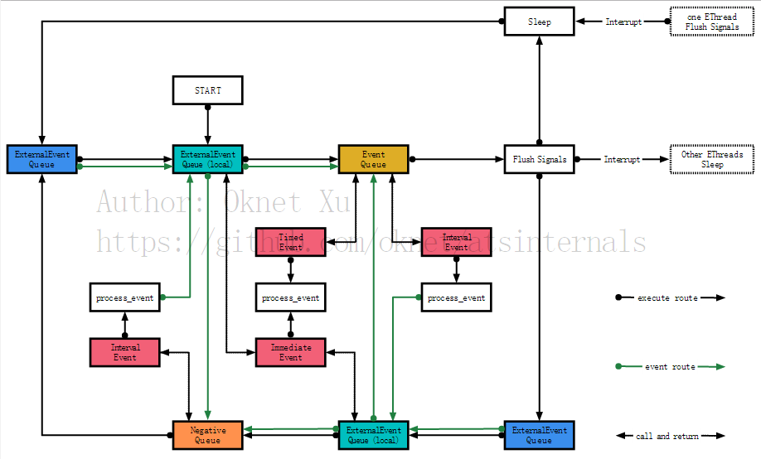
Event Routing Map

Slide 6
IOCore Net Sub-system
Base
  Polling component
    EventIO
    PollDescriptor
    PollCont
  NetVConnection
  IOBuffer
  VIO
  Socket component
    Connection
    Server
Core
  NetAccept
  NetHandler
  InactivityCop
  Throttle
  UnixNetVConnection
  Probe component
    ProtocolProbeSessionAccept
    ProtocolProbeTrampoline
Interface
  UnixNetProcessor

Slide 7
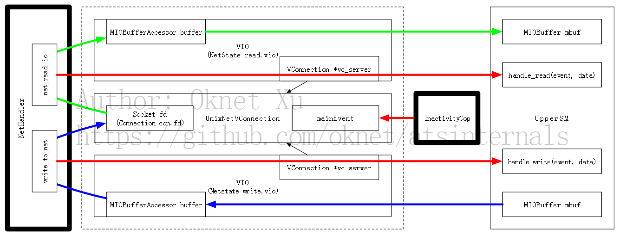
NetHandler & Its users

Slide 8
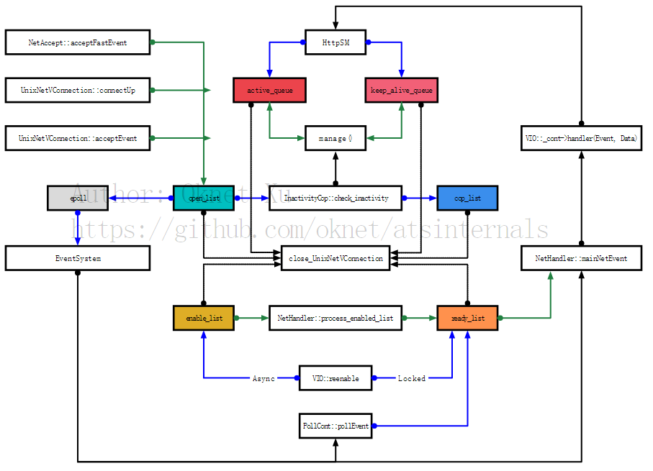
NetVC
Routing
Open_list
Cop_list
Enable_list
Ready_list
Active_queue
Keep_alive_queue

Slide 9
Thinking
NetHandler & InactivityCop should be standalone and unrelated to any protocol.
  HttpProcessor ?
  A interface to handle active_queue & keep_alive_queue.
NetProfileSM
  Attached to NetVC
  Describe how to receive data and send data
  Callback NET_EVENT to SM while data received
  Handle SSL Handshake , Socks Handshake, etc …
  TS-4322 & PR#1131

Slide 10
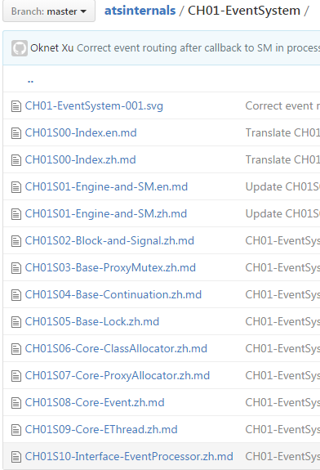
Multi Language Edition
Named Style
  Filename.[country name].md

Slide 11
Thanks.

