Slide 1
Disk Hot Swap
Zhilin Huang
zhilhuan@cisco.com

Slide 2
Motivation
Traffic Server is designed to be tolerant to disk failures, but there is no corresponding disk recovery mechanism available w/o restart service.
In the production systems, restarting Traffic Server service in a cache node is service impacting.
Simplicity of implementation
Low risk
Notes:
Feature required from our customer (Service Provider)
We are supporting Cisco Video CDN products for SP. There are some feature gaps.
Our next generation of CDN product will be build on top of TC and ATS
Thanks for the support from the open source community, and we are willing to contribute back to the community.

Slide 3
Prerequisites
The ATS startup logic will not be changed. As the current design, “storage.config”, “volume.config” will only be loaded at ATS startup.
Only Raw disk recovery is supported.
For a disk to be a candidate for hot-swap, that disk recovered must be listed in “storage.config”, and used by ATS as an operational disk after the process startup done.
The replaced disk must have equal or larger size than the old (failed) disk. And the recovery will only use the same storage size as the old disk.
Notes:
We will only reuse the Data Structure already built at startup.

Slide 4
Disk Hot Swap Procedure
Offline a bad disk
  traffic_ctl storage offline <path-of-the-disk>
Replaces the disk hardware, and makes sure that the path of the disk is persistent.
Online the replaced disk
  traffic_ctl storage online <path-of-the-disk>
Check status of all disks
  traffic_ctl storage status
Notes:
Linux disk name is not consistent, relies on persistent dev naming feature.
If “traffic_ctl storage online” not entered, nothing impacted.

Slide 5
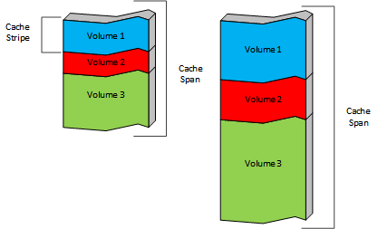
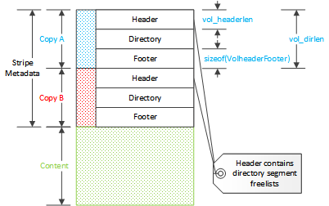
Cache Architect Re-Capture
Notes:
URL hashed, and assigned to a stripe
Raw disk, no (os) file system, ATS handled by itself
Disk Header, Stripe Meta data cleared

Slide 6
Cache initialization
Load and parse “storage.config” (by Store::read_config), “volume.config” (by ConfigVolumes::read_config_file).
Open the raw disk file, read the disk header.
Calculate size of each volume and stripe based on configuration and storage size. Then create stripes for each disk (by CacheDisk::create_volume).
Read stripe metadata (via Vol::init).
After the cache initialized ready, ram cache will be created (via CacheProcessor::cacheInitialized).

Slide 7
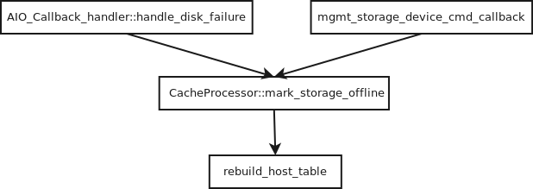
Disk Failure

Slide 8
Disk Recovery
traffic_ctl storage online <path>
DiskHotSwapper::handle_disk_hotswap
path match in gdisks
disk is marked bad
DiskHotSwapper::mark_storage_online
open, fstat
reset cache stats
rebuild_host_table
SET_DISK_OKAY
propagate new fd
Clear disk and strip headers
Check: disk is a candidate?
Initialize meta data
Mark good
Notes:
A new class DiskHotSwapper will be defined. It is a subclass of Continuation to support asynchronous I/O. It encapsulates all the operations associated with disk hot swap.
A new command “traffic_ctl storage online <path-of-the-disk>” will be provided. And when it is triggered, gdisks will be checked to find a disk matching the path and marked as bad.
If found, a DiskHotSwapper instance will be created and scheduled immediately. The default handler will be set as DiskHotSwapper::handle_disk_hotswap ().
Call open(), and fstat(). If both are successful, then we have a new operational disk.
Get the geometry of the new disk, if it has smaller size than the old one, reject.
Use only the same size of the old disk.
Close the old fd, and propagate the new fd needs to various data structures like CacheDisk, Vol, aio_reqs.
Initiate a series of asynchronous calls to perform disk I/O on the new disk to:
Write Disk Header to the start of the disk.
Write Vol headers for each stripe of the disk.
After IO operation done, call to DiskHotSwapper::mark_storage_online. It is similar to mark_storage_offline: resets a couple of global cache stats; and more importantly, rebuilds the assignment table.

Slide 9
Limitations
To avoid implementing complicated logic of recovering disk content, a replacement disk will always be cleared. Therefore, no previous cached contents will be used.
Only the same size of the old disk will be used for cache. This will help to reuse the already existing data structures for the old (failed) disk, and avoid the complexity to rebuild those data structures.
If the replacement is larger, then after a ATS process restart, the full new disk may be used for cache. This could cause the cached content become invalid.

Slide 10
Disk Status Inspection
traffic_ctl storage status
Will print to “diags.log”
Exmaple:
[May 12 22:15:44.138] Server {0x2b1c38391700} NOTE: /dev/disk/by-path/pci-0000:03:00.0-scsi-0:0:1:0: [good]
[May 12 22:15:44.138] Server {0x2b1c38391700} NOTE: /dev/disk/by-path/pci-0000:03:00.0-scsi-0:0:2:0: [bad]
Notes:
Add example

Slide 11
Thanks!
Notes:
Status:
Basic feature working, need more test.
Work done in 5.3.2, need merge back to master before PR to open source

